Slide 1

MALIGNANT COMMENTS CLASSIFICATION
Submitted by:
ANISH ANTONY

Slide 2
ABSTRACT:
In the cyber era, social media is flooded with cyber bullying and hate comments. There must be an online hate comment predicted model to predict the comment behaviour so that it can be controlled and reduced. The main objective is text process the review and perform language text processing thereby predicting the rating with the review text. This can be done using various language processing techniques such as Count Vectorizer and machine learning algorithms
Keywords: Review, Rating, Type of comments, Data cleaning, Count Vectorizer, Naïve Bayers

Slide 3
The features used in the dataset are:
Malignant: It is the Label column, which includes values 0 and 1, denoting if the comment is malignant or not.
Highly Malignant: It denotes comments that are highly malignant and hurtful.
Rude: It denotes comments that are very rude and offensive.
Threat: It contains indication of the comments that are giving any threat to someone.
Abuse: It is for comments that are abusive in nature.
Loathe: It describes the comments which are hateful and loathing in nature.
ID: It includes unique Ids associated with each comment text given.
Comment text: This column contains the comments extracted from various social media platforms.

Slide 4
Data Analysis:
As the task was to figure out whether the data belongs to zero, one, or more than one category out of the six listed above,
The first step before working on the problem was to distinguish between multi-label and multi-class classification.
In multi-class classification, we have one basic assumption that our data can belong to only one label out of all the labels we have.
In multi-label classification, data can belong to more than one label simultaneously.
This dataset contains 6 types of comments
They are also present with different combinations
Mostly the dataset has positive comments
The dataset features are also imbalanced

Slide 5
Cont’d…
Criteria | Toxic Comment | Clean comment
Average comment length | 303 | 404
Median comment length | 128 | 216
Percent of capitalized characters in comments | 14 | 5
Average word length in comments | 4.1 | 4.4
Exclamations in comments | 3.5 | 0.3
questions in comments | 0.60 | 0.40

Slide 6
Data Cleaning:
Removing blank spaces
Converting to lower case
Preparation for removal of dots
Updating the list of stop words
Removing words less than 2 letters

Slide 7
Hardware and Software Requirements and Tools Used:
Hardware – PC Windows 10, 4 GB Ram
Software – Google chrome, MS Excel, Python, Selenium webdriver
Libraries – Pandas, NumPy, Matplotlib, Seaborn, sklearn, SciPy. Stats
Browsing – Google Chrome
Webscraping – Python, Selenium webdriver
Data cleaning – Python, Pandas, NumPy & SciPy. Stats
Data visualization – Matplotlib & Seaborn
Machine learning – Sklearn

Slide 8
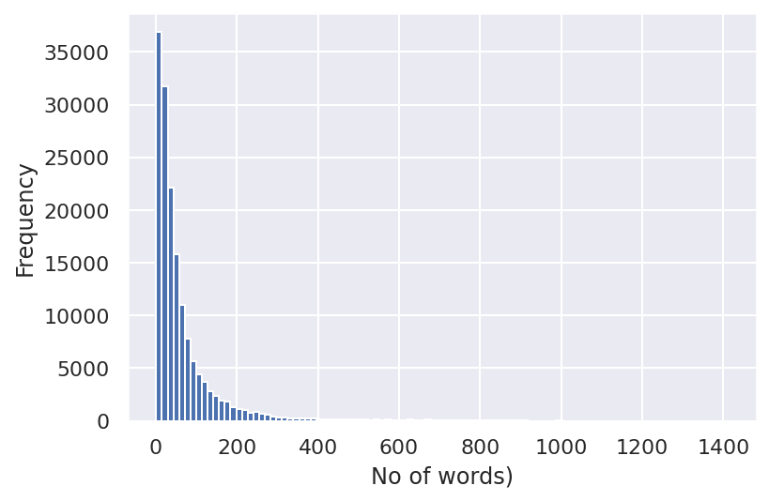
No of words vs Frequency:

Slide 9
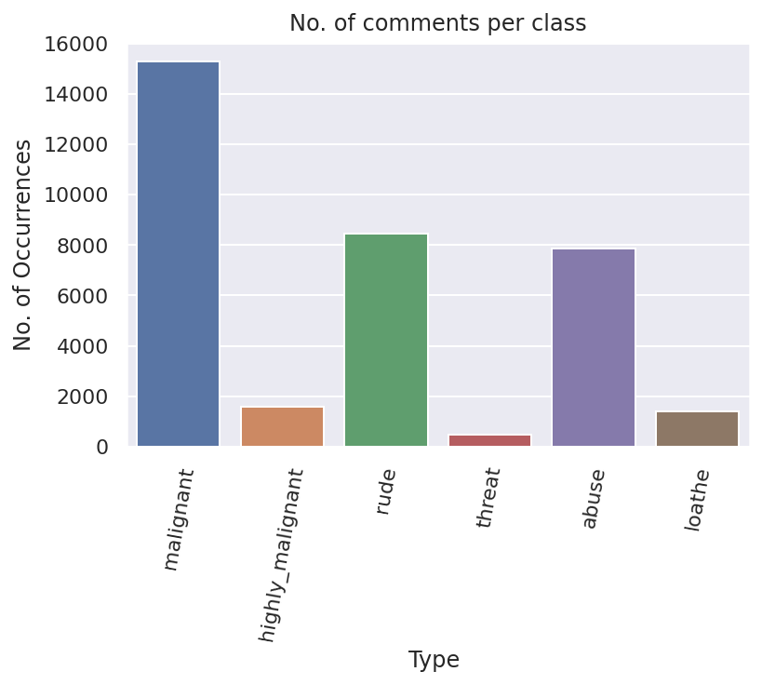
Percentage of Ratings:

Slide 10
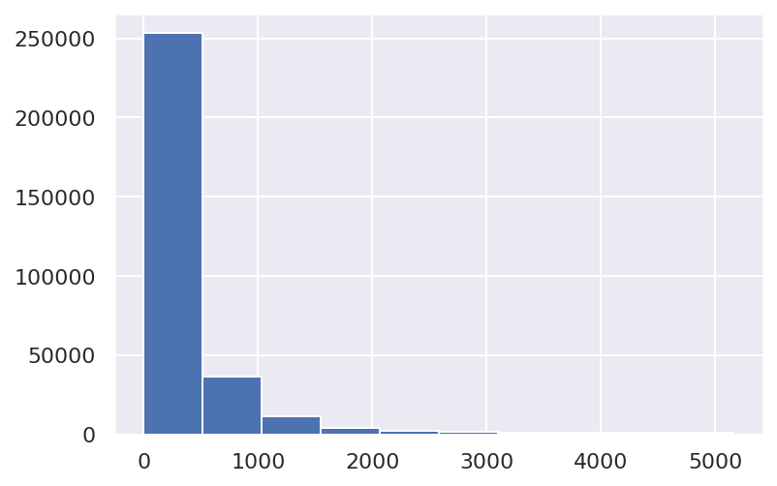
Character Length:

Slide 11
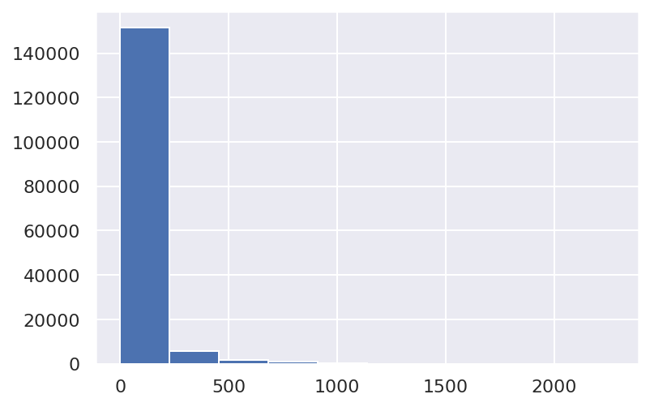
Word Length:

Slide 12
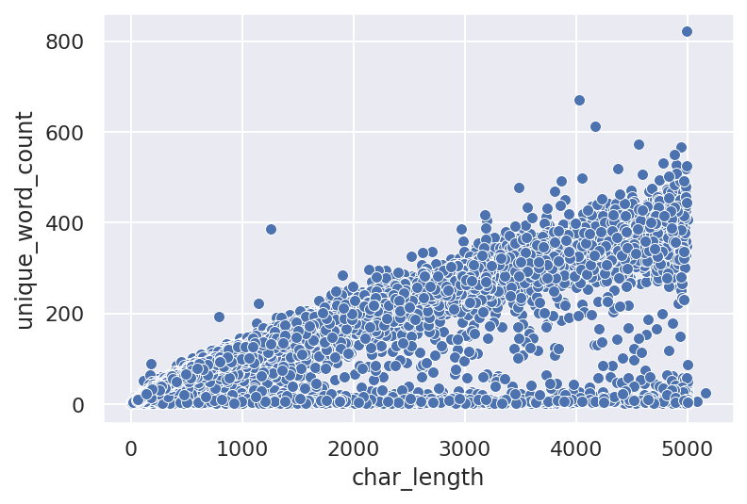
Word Length vs Character Length:

Slide 13
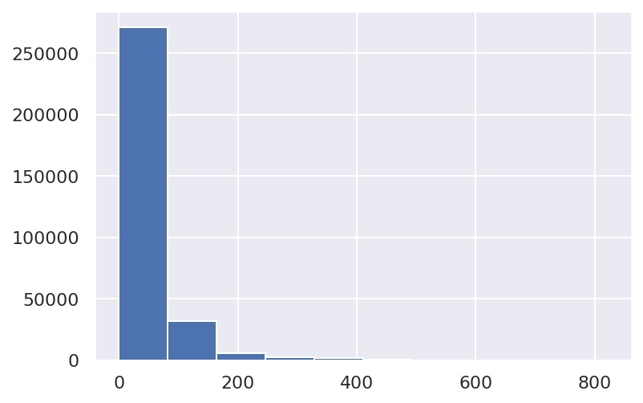
Unique Word:

Slide 14
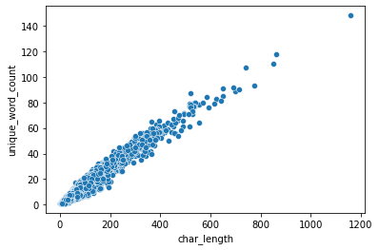
Unique Word vs Character Length:

Slide 15
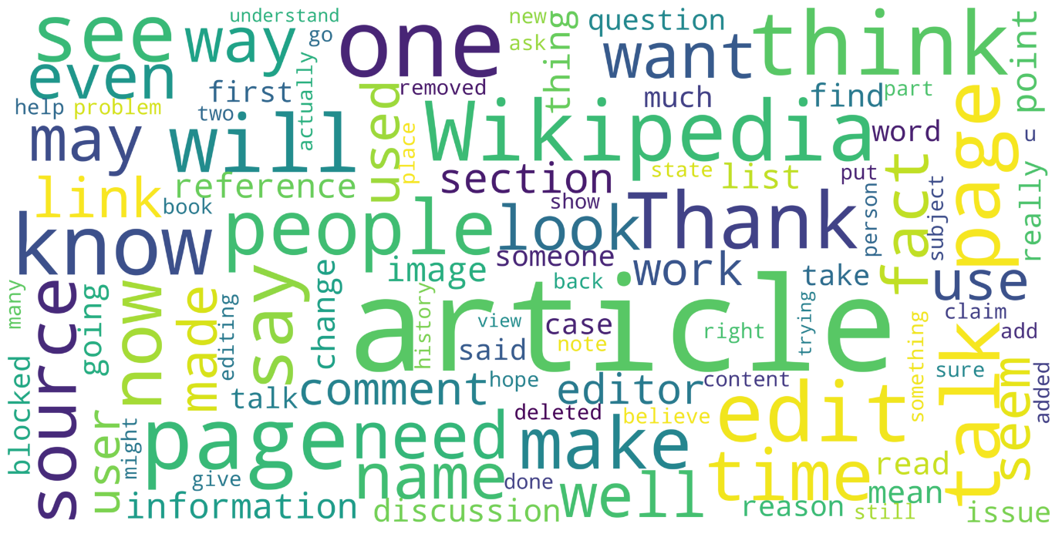
Word cloud before cleaning:

Slide 16
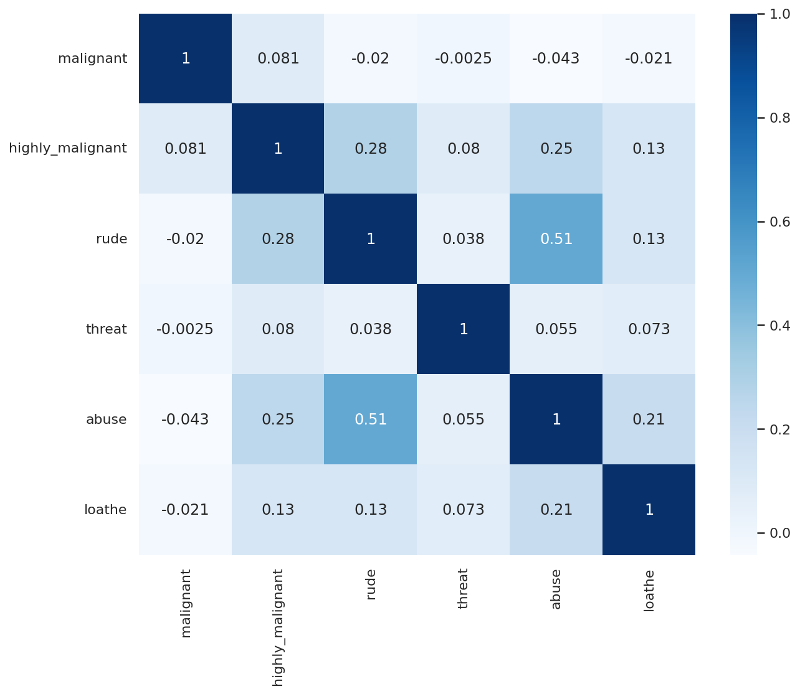
Heatmap of type of comments:

Slide 17
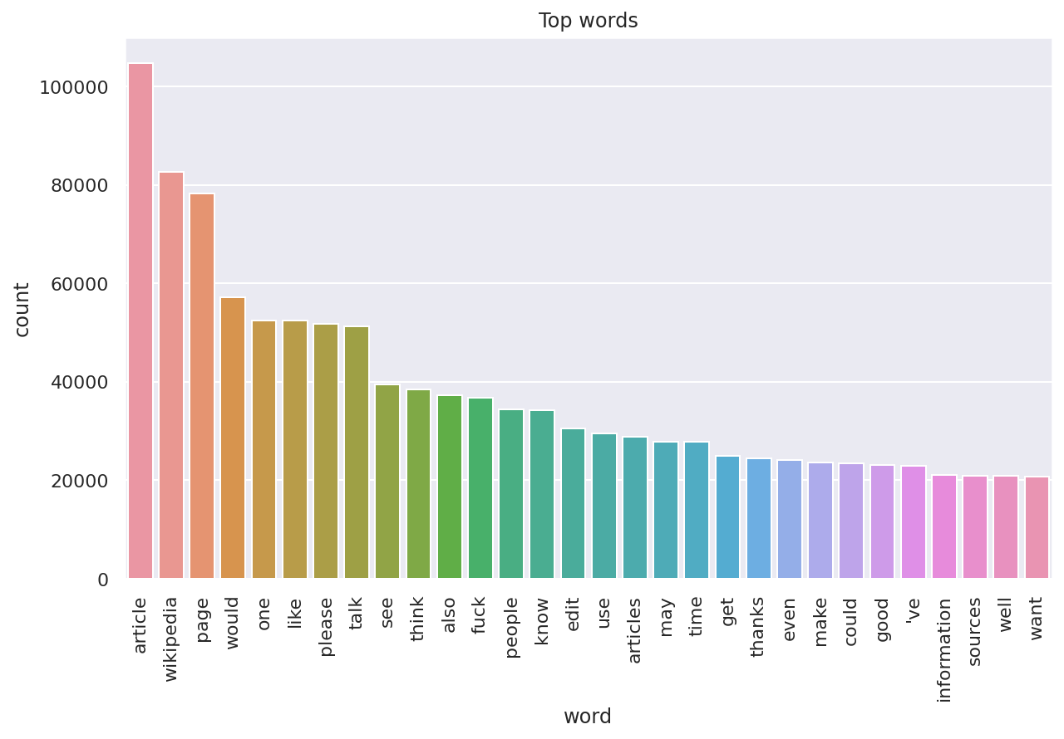
Frequent words:

Slide 18
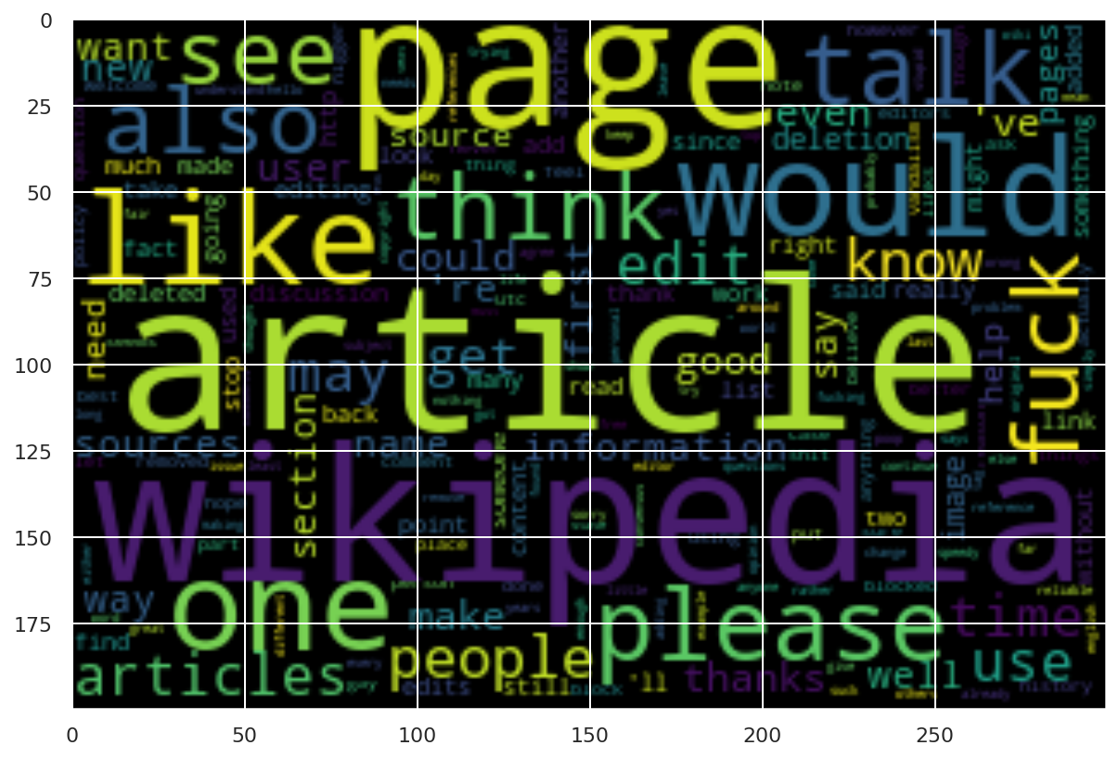
Word cloud after cleaning:

Slide 19
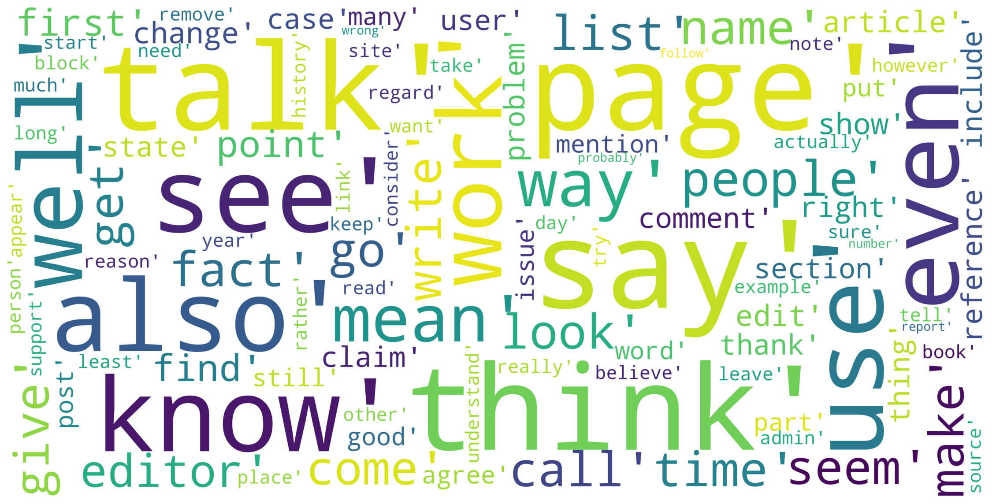
Word cloud for Malignant comments:

Slide 20
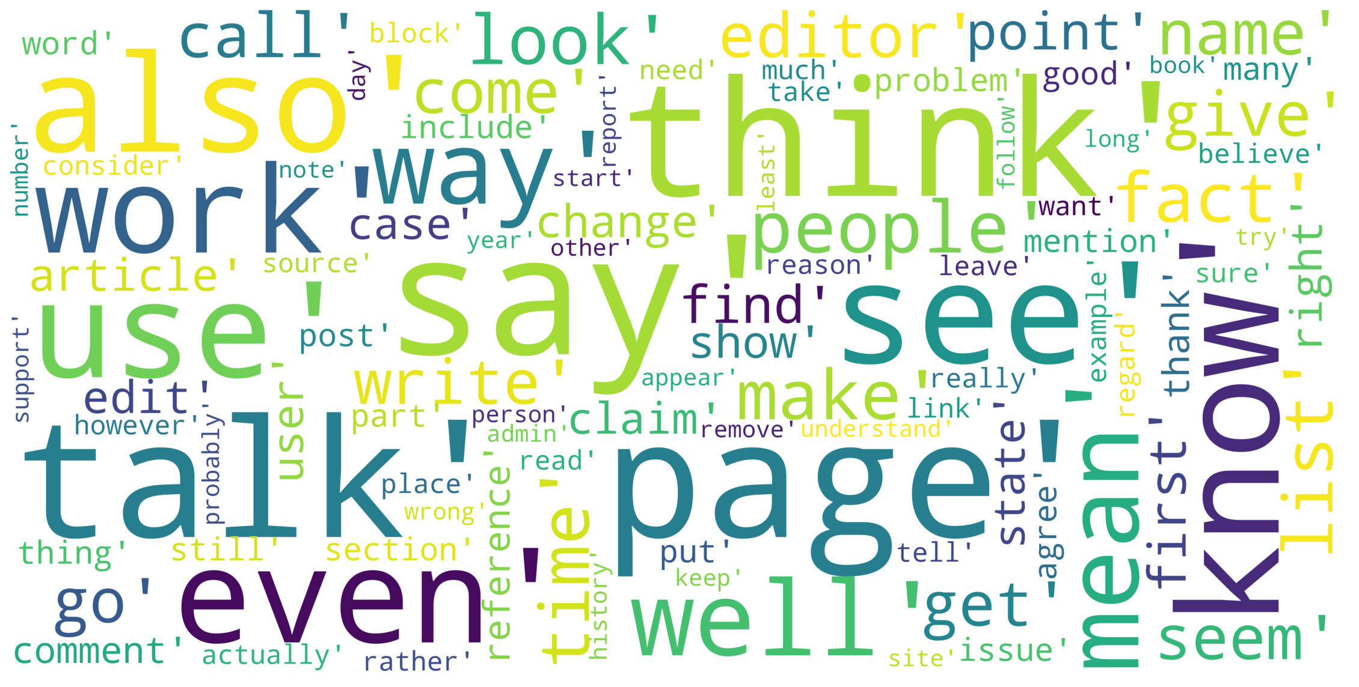
Word cloud for Highly Malignant comments:

Slide 21
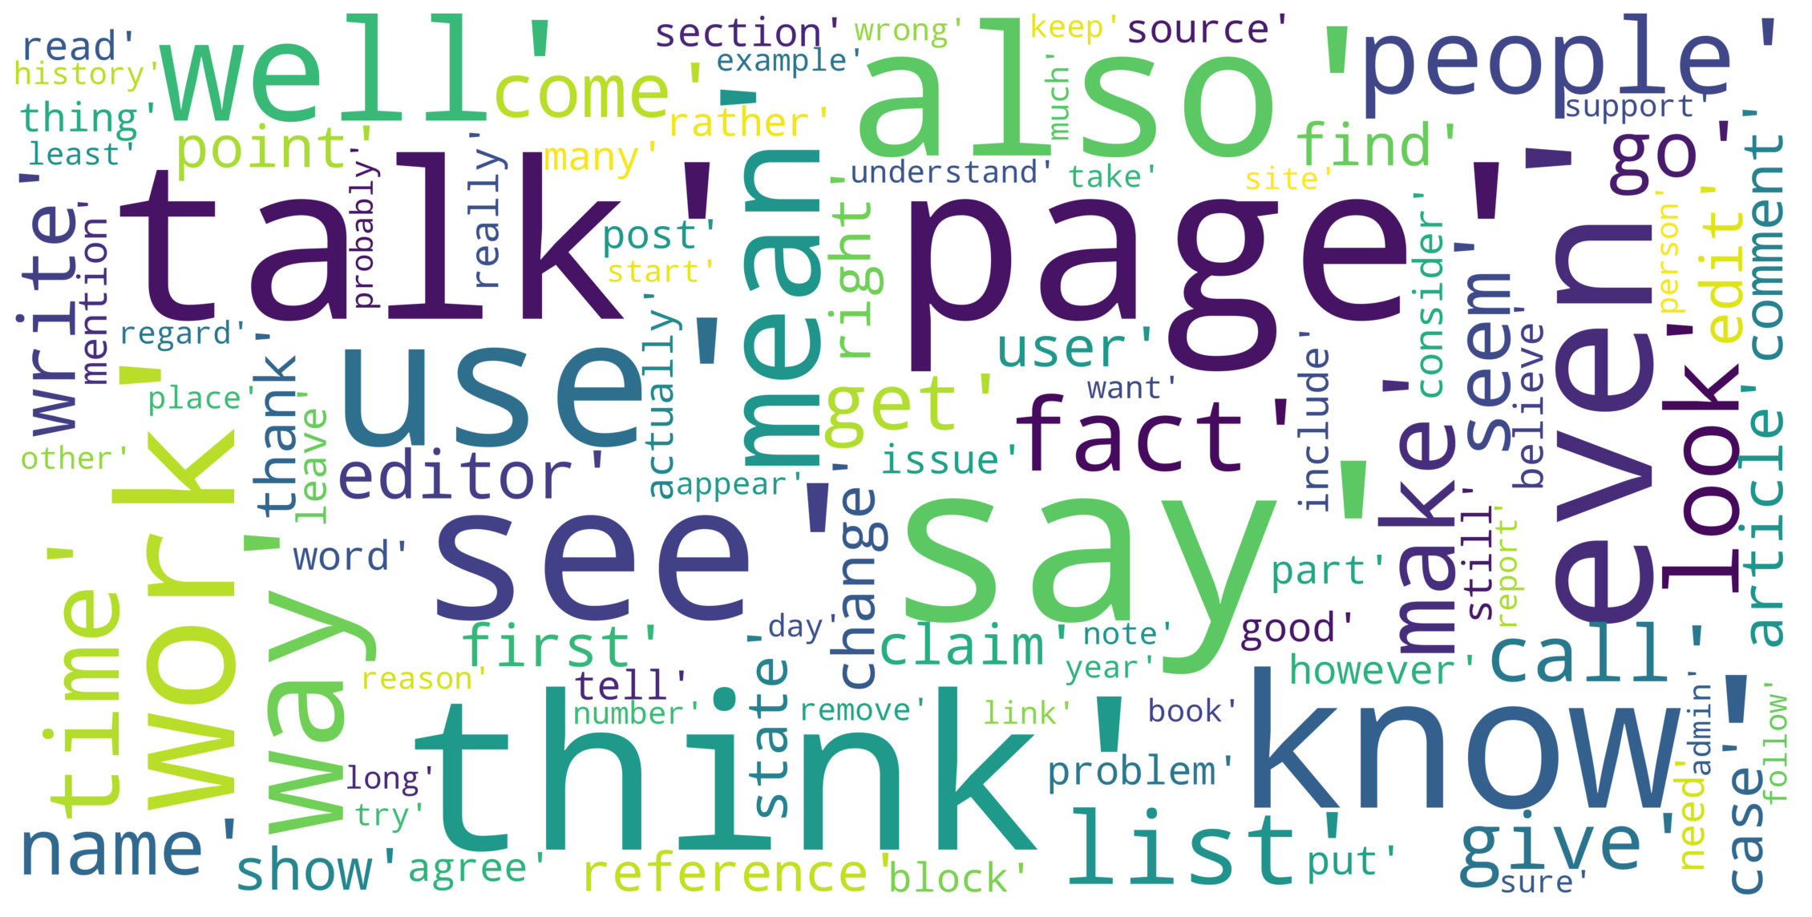
Word cloud for Rude comments:

Slide 22
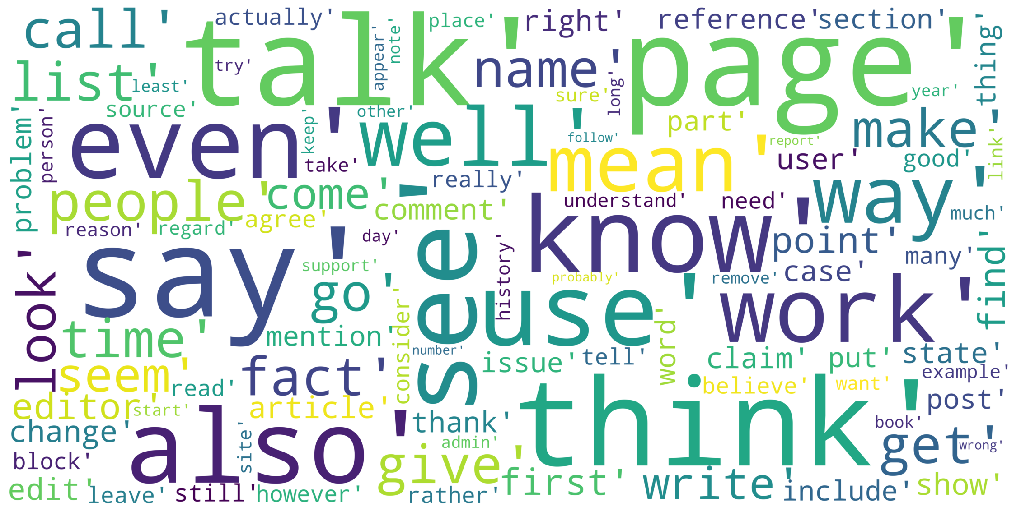
Word cloud for Threat comments:

Slide 23
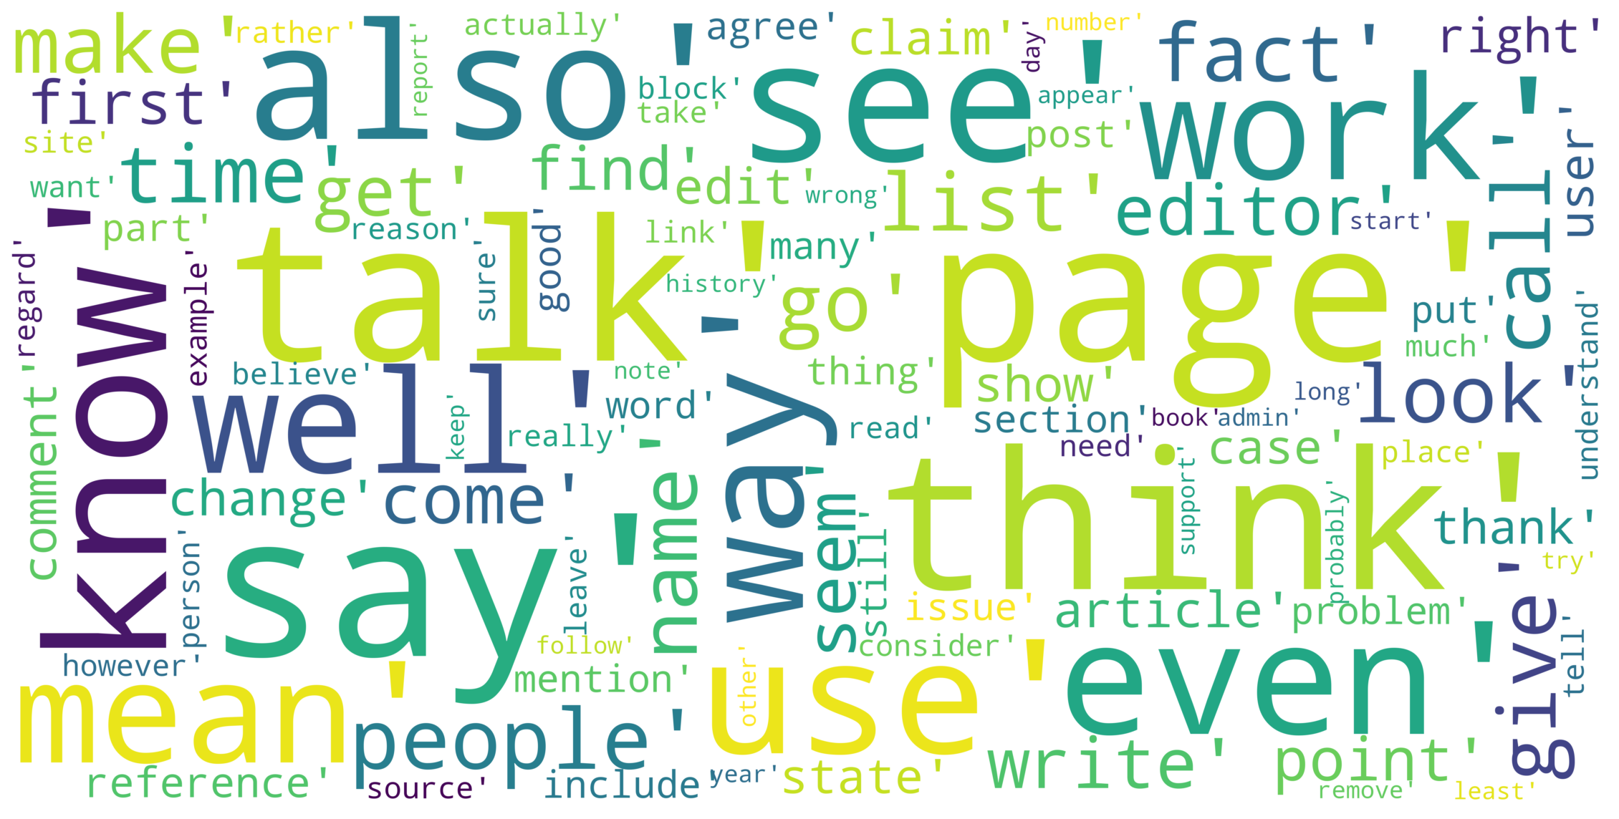
Word cloud for Abuse comments:

Slide 24
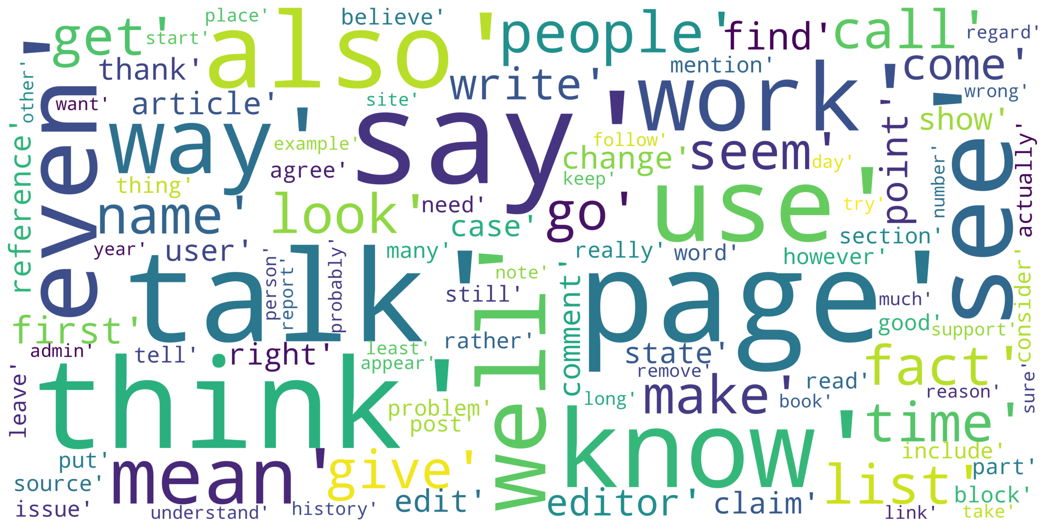
Word cloud for Loathe comments:

Slide 25
Testing of Identified Approaches (Algorithms):
Random Forest Classifier
Linear SVC
Logistic Regression
Multinomial NB
Bernoulli NB
LGBM Classifier
SGD Classifier

Slide 26
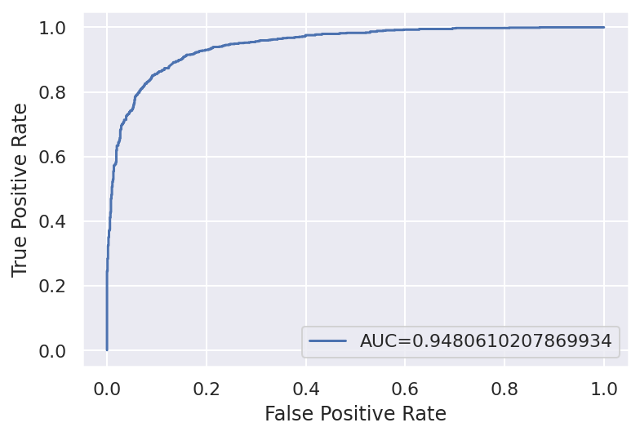
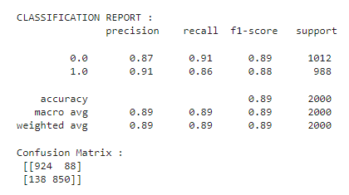
Malignant comments:
Accuracy Score: 88.7

Slide 27
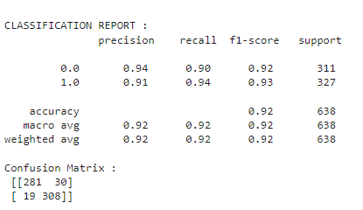
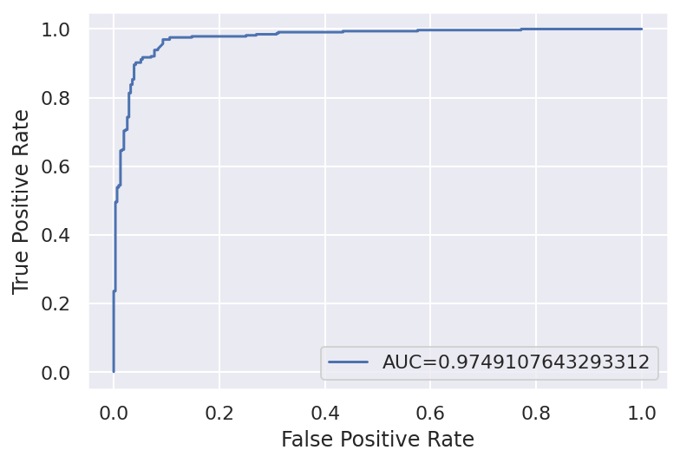
Highly Malignant comments:
Accuracy Score: 92.319

Slide 28
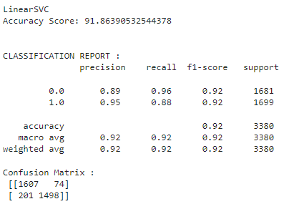

Rude comments:

Slide 29
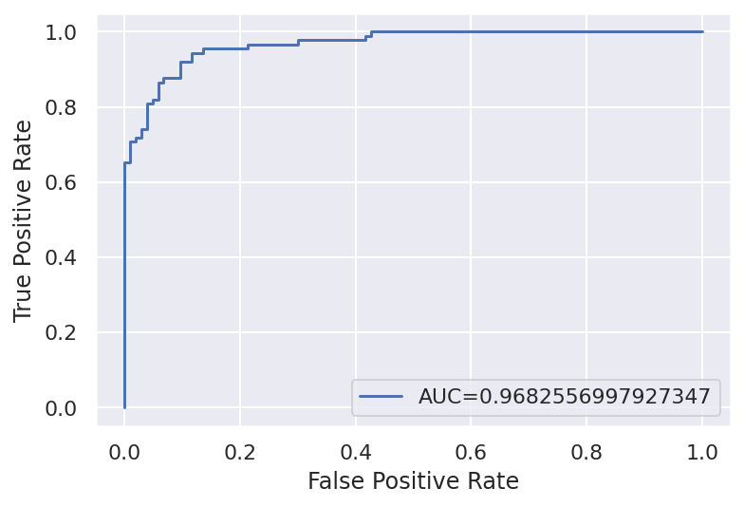
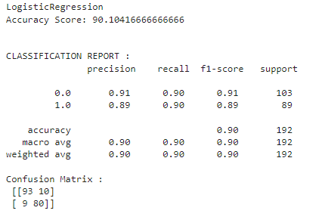
Threat comments:

Slide 30
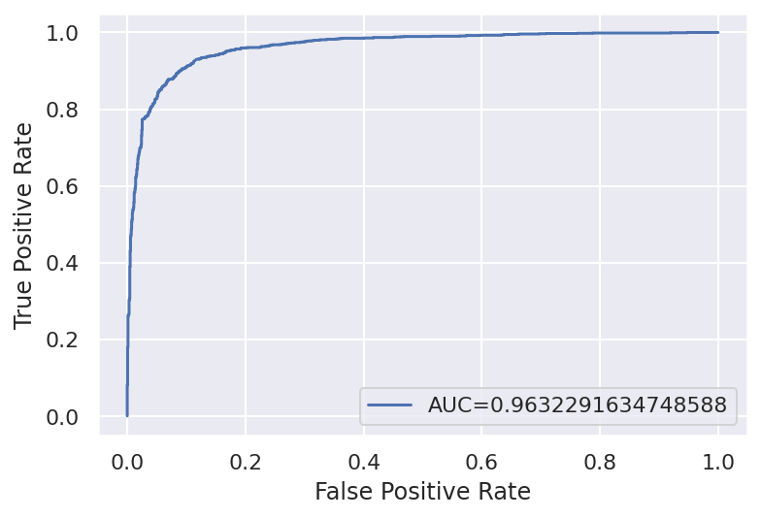
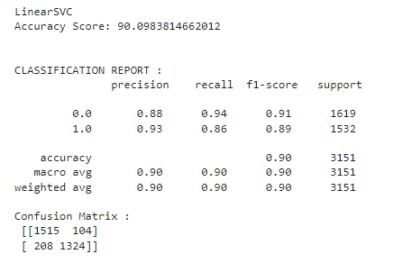
Abuse comments:

Slide 31
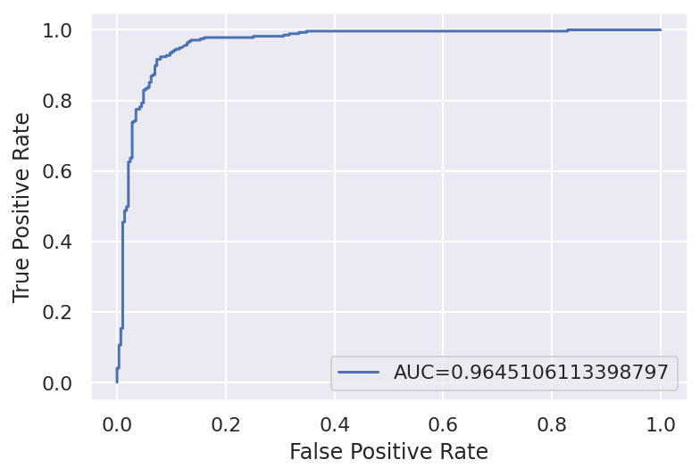
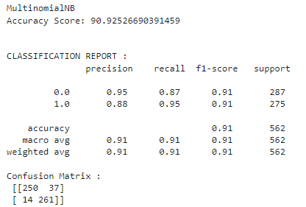
Loathe comments:

Slide 32
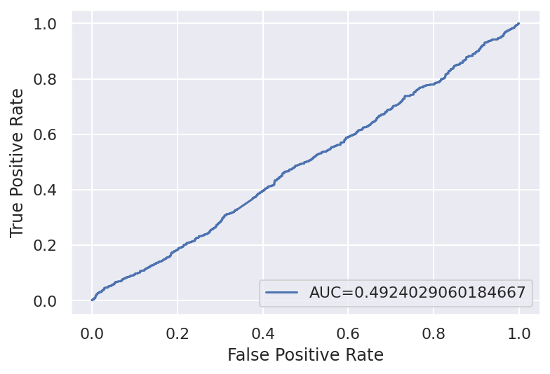
Test Data:

Slide 33
Limitations:
We have not removed all kinds of stopwords as the dataset is huge
We have not used stemming as it give less accuracy Limited training model algorithms Only partial data is used for prediction Hemming loss not calculated

Slide 34
Future Work:
In NLP, there are different methods to predict the data, in future we will use transformers, bert model to improve the predict the data
During Testing, we have taken only 4 basic classification algorithm, it will be tested different algorithms in future.
We will predict the data for all type of comments

